Slide 1
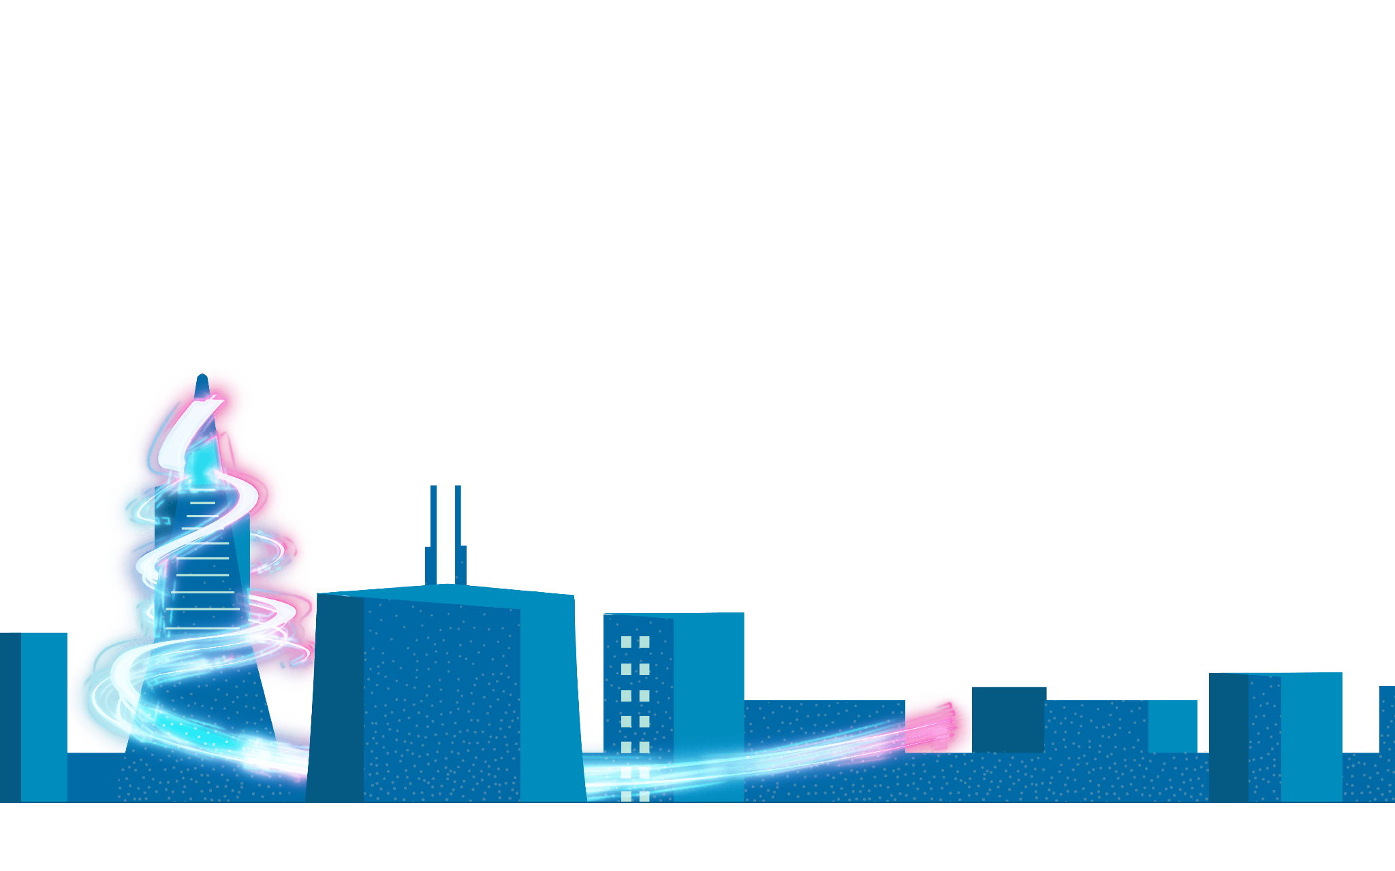
Sponsorship Opportunities 2022

Slide 2
Let’s Glow SF is back,
growing bigger & brighter in 2022.
December 2 - 11, 2022
Nightly Light Shows: 5:00 pm - 10 pm

Slide 3
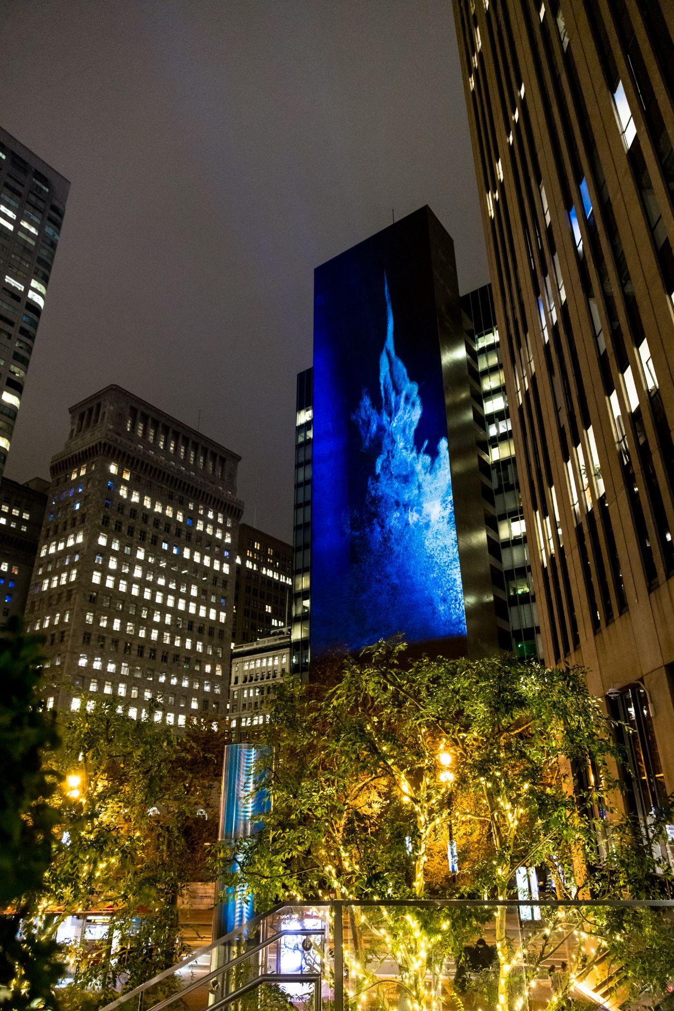
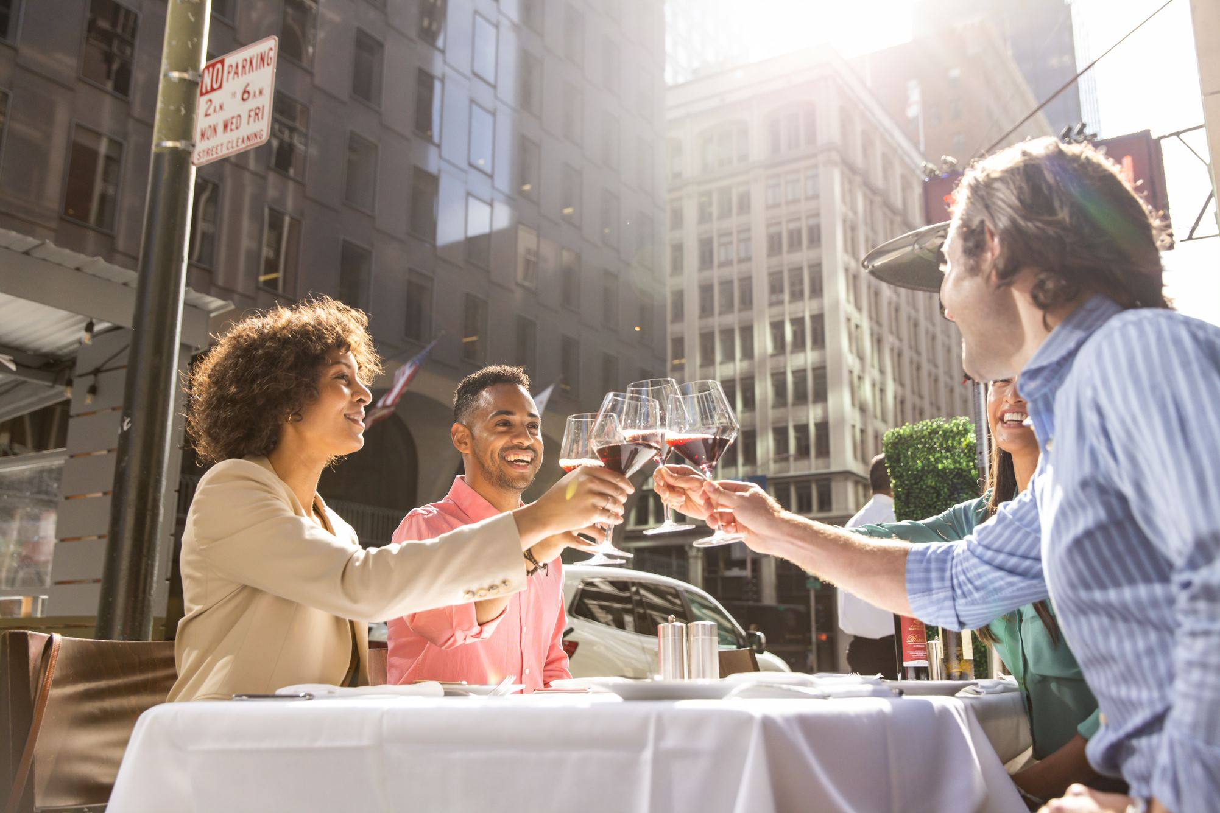
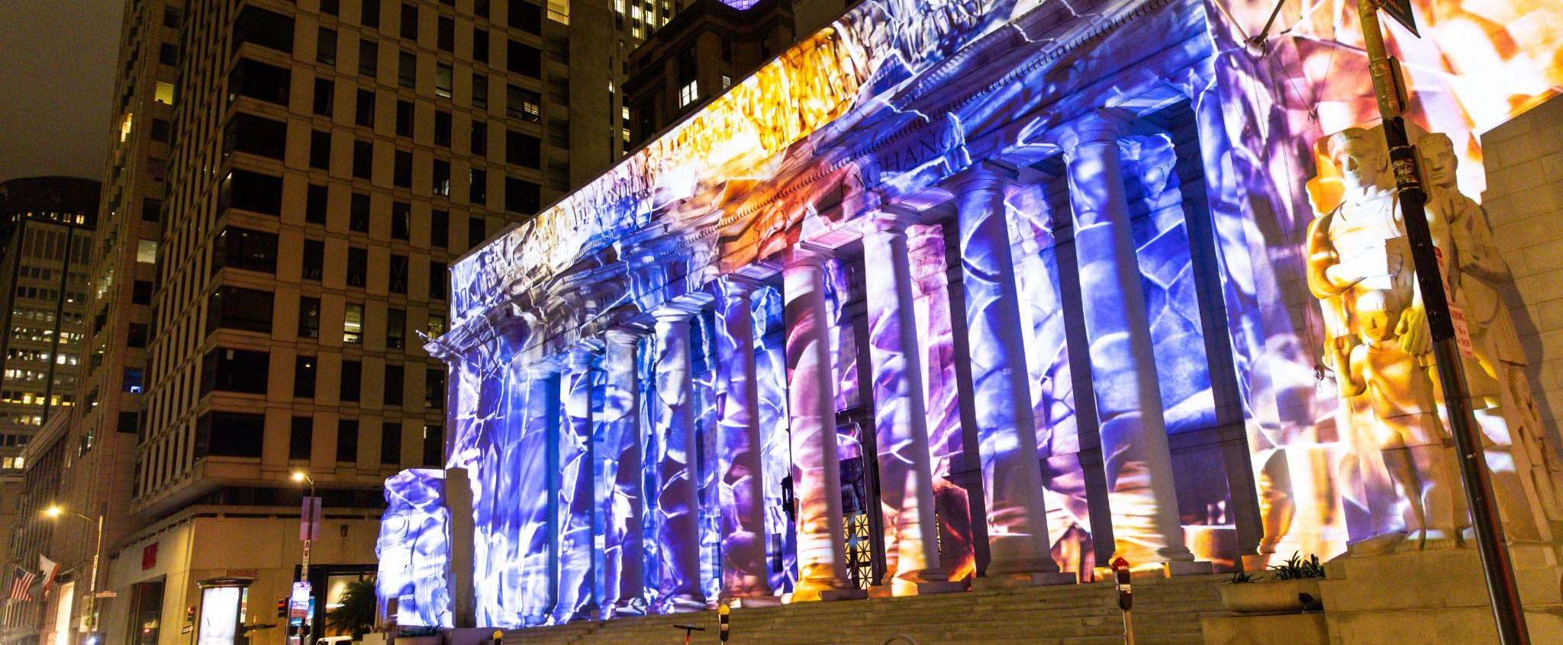
BE PART OF THE GLOWING RECOVERY
The Downtown SF Partnership is making a significant investment to revitalize downtown and reopen San Francisco after lockdown and business closures. We need your help to build Let’s Glow SF as a new holiday tradition to bring residents, workers, and visitors back to downtown.
Restaurants, bars, and shops have reopened and need all the support they can get during this holiday season. Be a part of SF’s recovery while celebrating the diversity and talent of Bay Area artists.
Let’s Glow SF offers a multitude of opportunities to make a positive impact on downtown San Francisco.

Slide 4
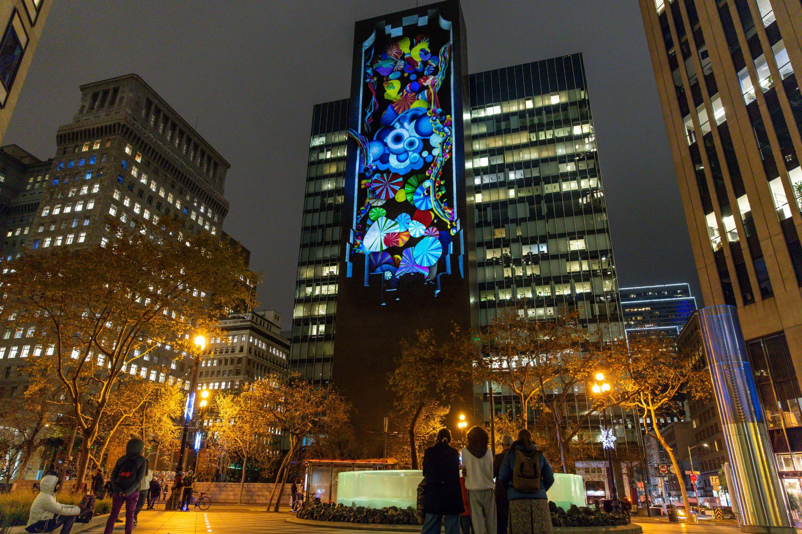
WHAT IS LET’S GLOW SF?
High tech creations on a massive scale
In December of 2021, the Downtown SF Partnership hosted the premier Let’s Glow SF, an activation to revitalize downtown San Francisco while celebrating the holiday season like never before. The largest holiday projection mapping display in the US drew Bay Area residents to the Financial District to not only celebrate the holidays but also provide a much needed economic boost to the area while highlighting artists of all backgrounds.
In 2021, Let’s Glow SF featured:
A diverse group of 12 cutting edge artists and three content studios, both local and global
Projections on four towering buildings throughout the Financial District
5-7 minute shows on each building that ran continuously from 5:30pm – 10pm for ten nights
A VIP launch party the first night of the event and a press conference with opening statements by the Mayor and local stakeholders

Slide 5
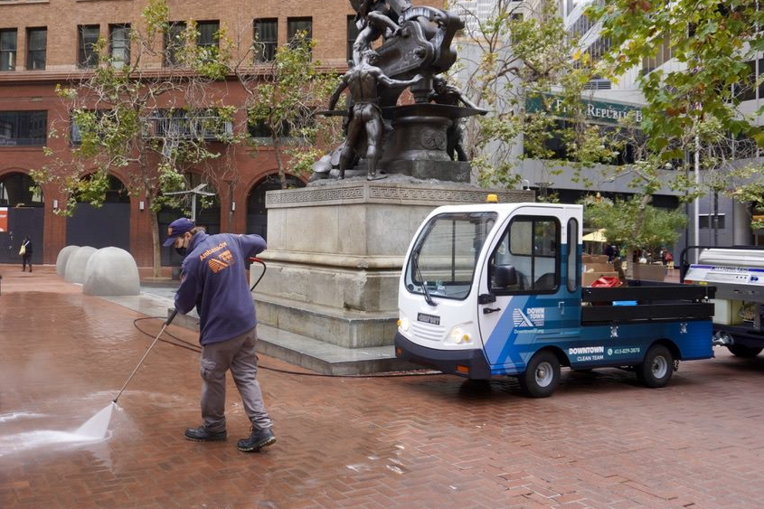
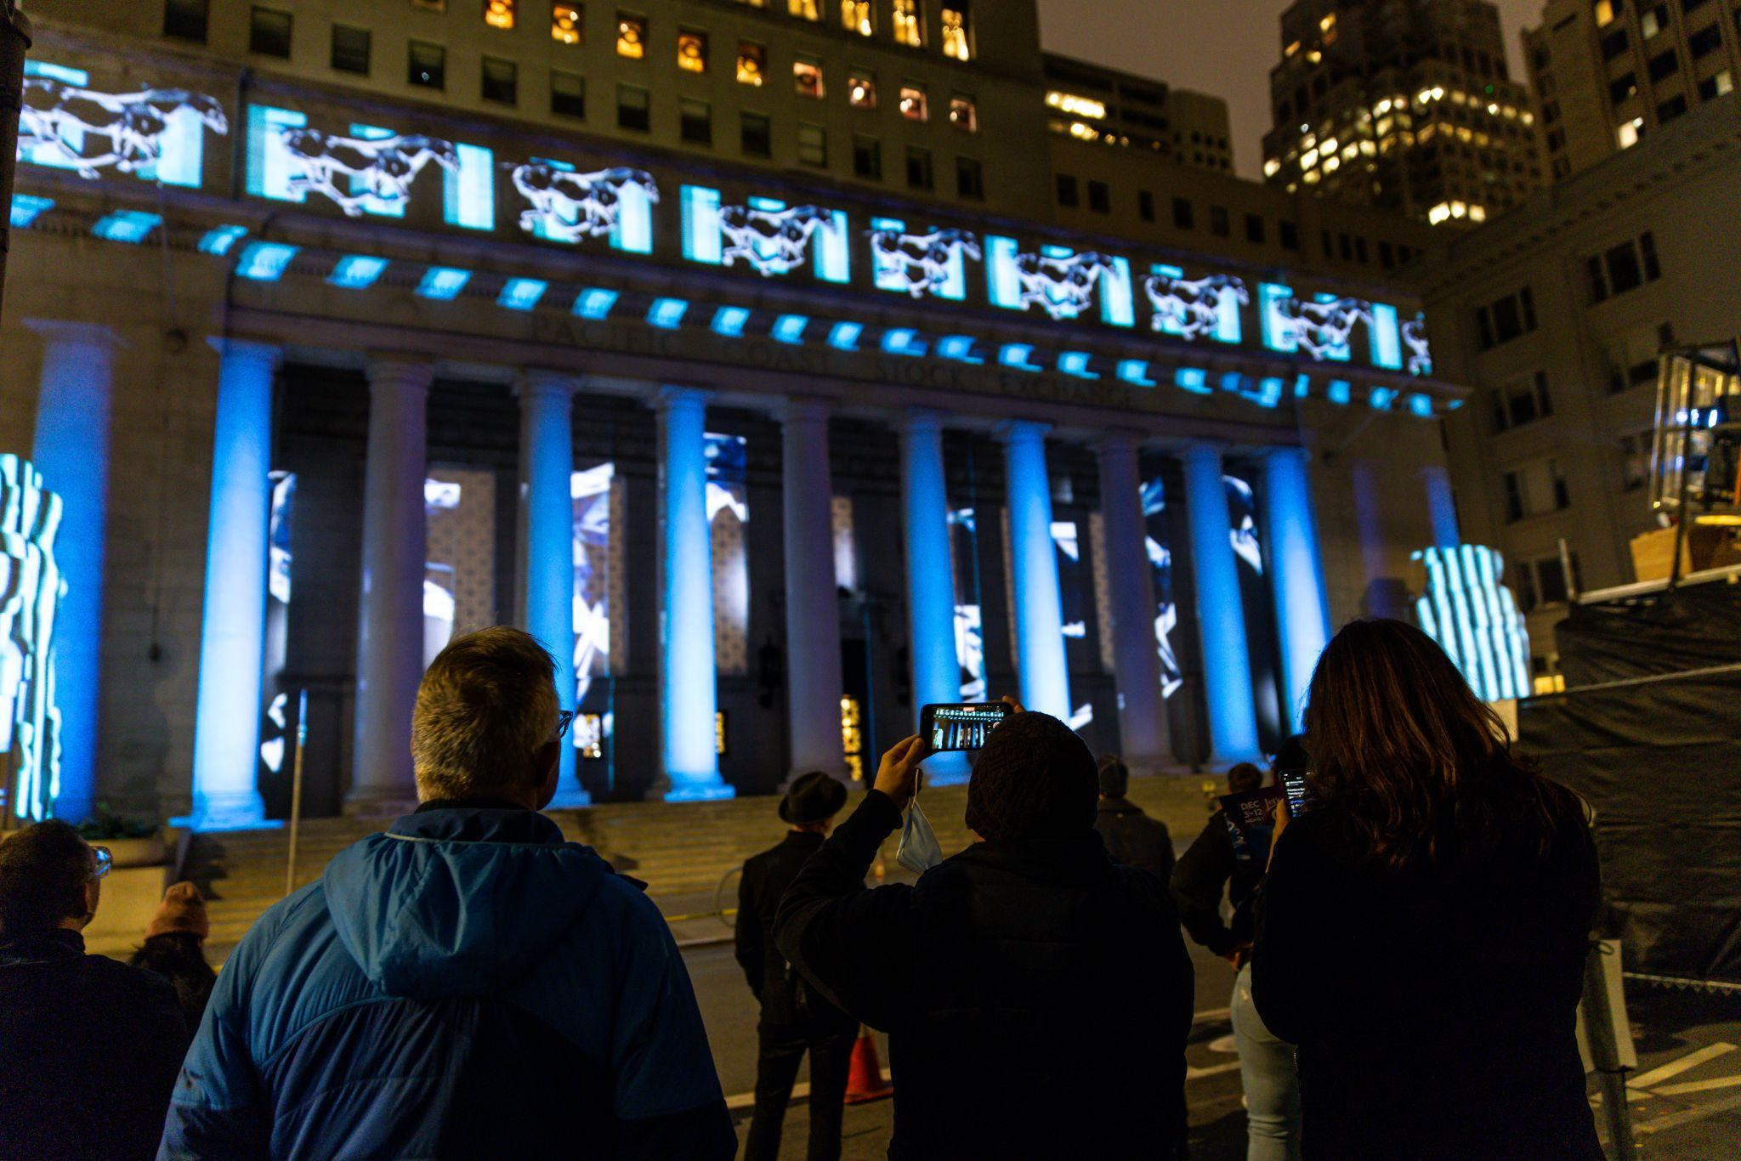
PRESENTED BY
The Downtown SF Partnership, the Community Benefit District that serves San Francisco’s Financial District and Jackson Square, launched the premier year Let’s Glow SF in 2021.
The Downtown Community Benefit District is a 501(c)(3) non-profit organization founded in 2020. Developed by a coalition of property and business owners, the District includes two of the oldest continuous business districts in San Francisco. The Downtown SF Partnership funds special benefit services over and above what the City already provides within a 43-block radius. These services include cleaning, safety, district identity and promotion, and public space activations.
As part of the Downtown SF Partnership’s mission to improve the District’s vitality, Let’s Glow SF activates the District during the holiday season like never before.
Let's Glow SF is more than just a light show, it's a captivating activation of downtown San Francisco that awakens the imagination of what is possible for a city adapting to a post-lockdown world.

Slide 6
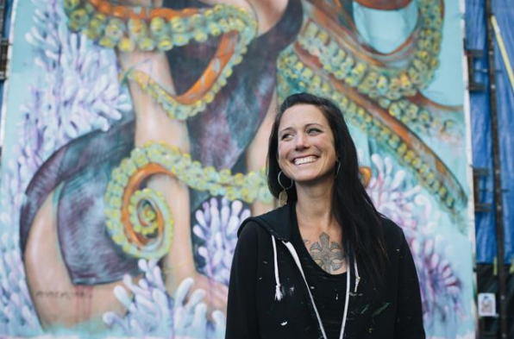
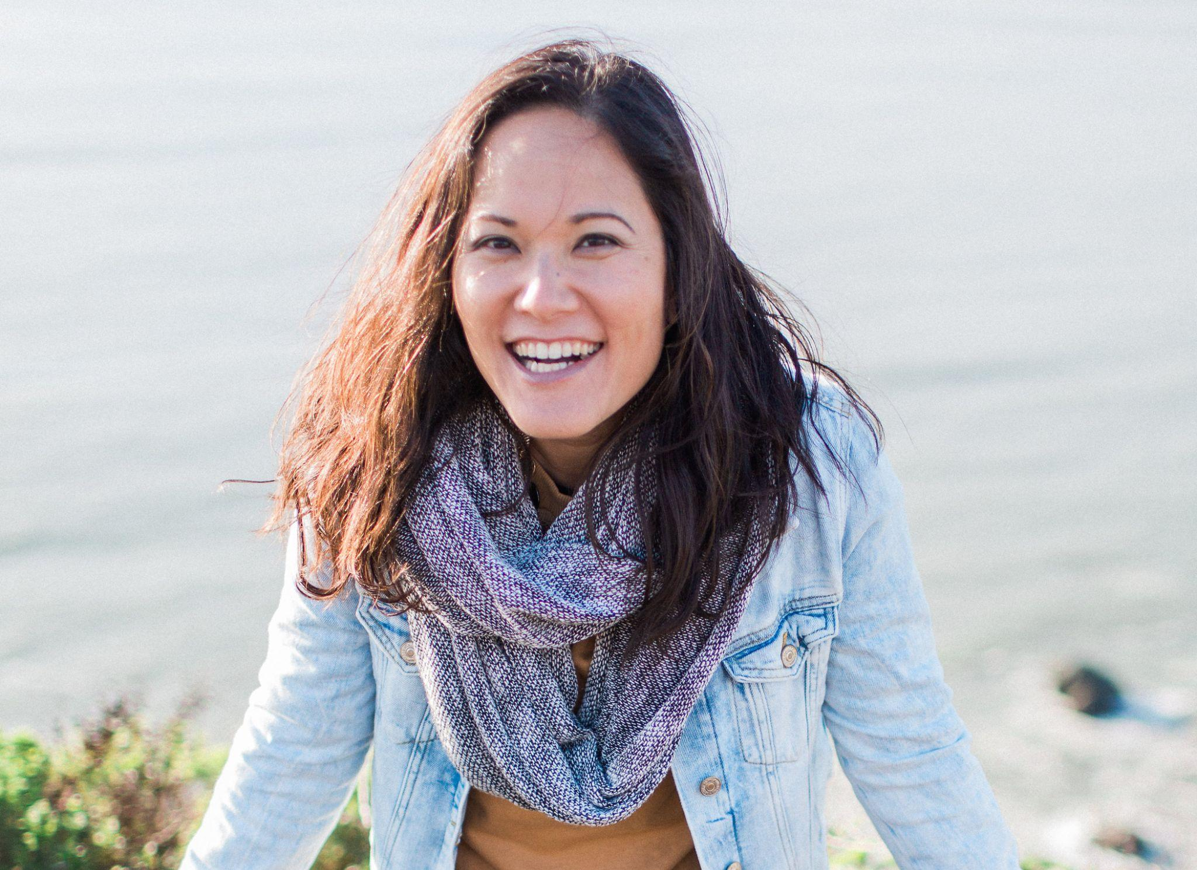
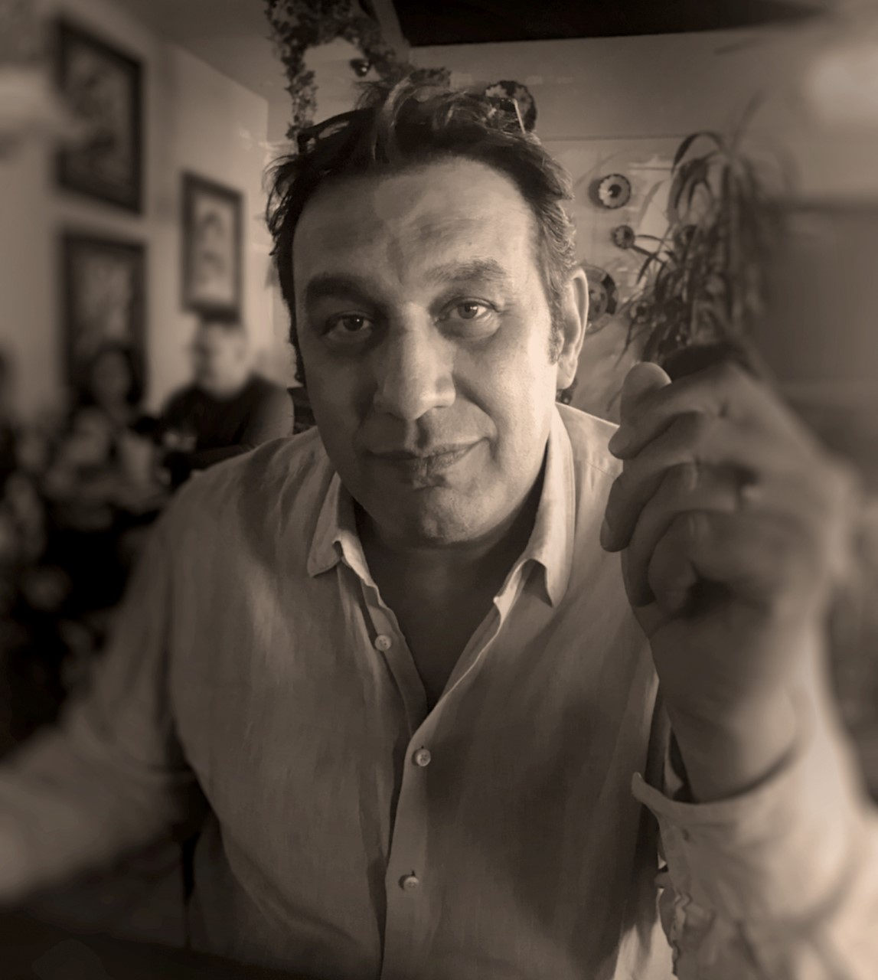
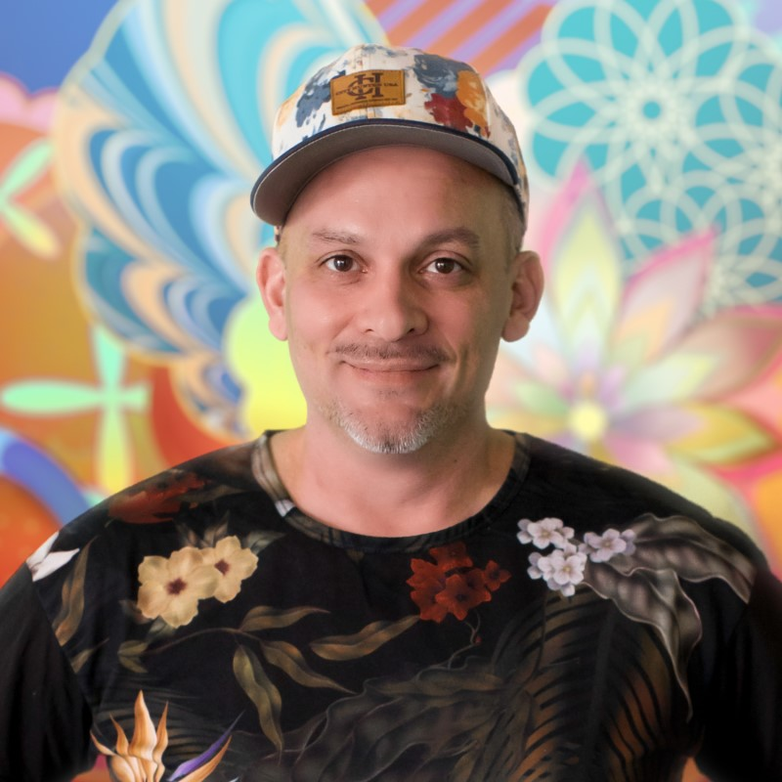
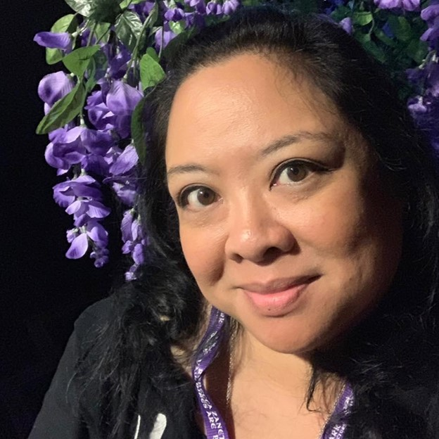
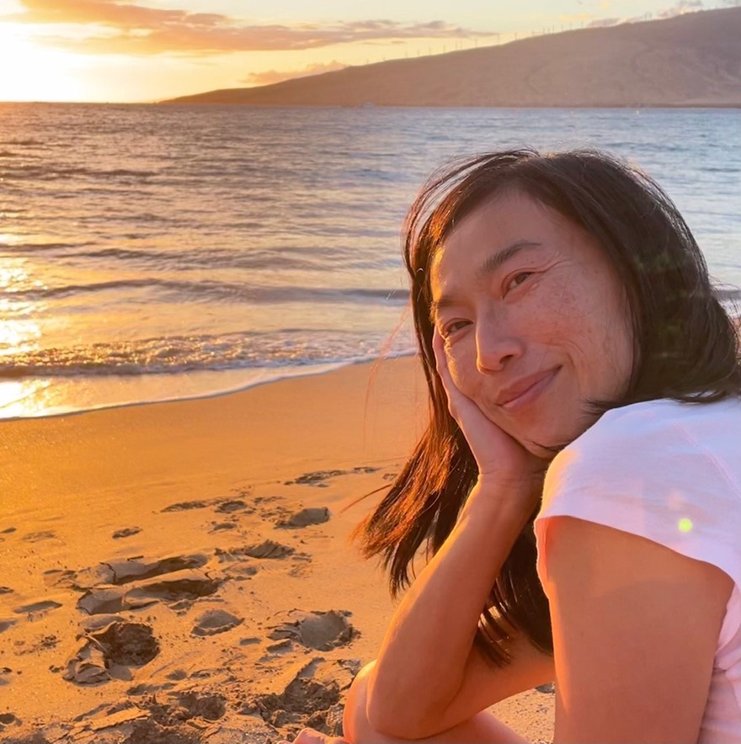
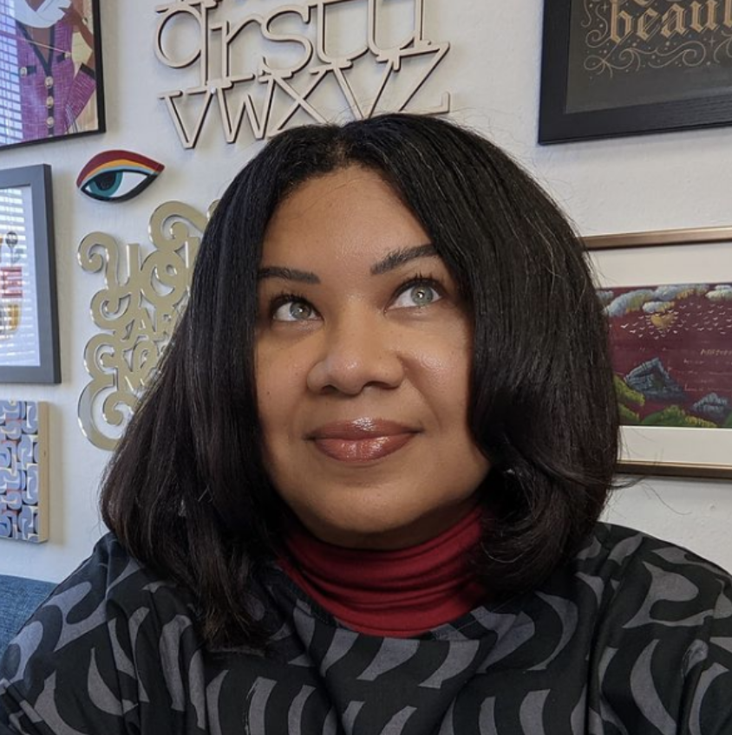
ABOUT THE ARTISTS
In 2021, Let’s Glow SF featured works from eight total artists: four local, one regional and three international companies that focus on digital, hand painting and other forms of content. All artists were selected for their creativity, content, and past achievements. Local artists included muralist, ceramicist and painter Ian Ross, multi-media artist Sophia Lee, muralist & illustrator duo Christina Paraiso-Chavez and Valerie Margolin, illustrator Erika L Chan, motion graphics artist Duncan Rogoff, animation artist Sean Capone, and muralist and fine artist Amandalynn.
Let’s Glow SF 2022 will continue to highlight artists of all backgrounds, especially those from the BIPOC and LGBTQ+ communities.

Slide 7
FAQ
How long has Let’s Glow SF been in existence?
2022 will be the 2nd year
Why host this event?
To help downtown SF businesses recover post-lockdown
How much is it to attend Let’s Glow SF?
$0! Let’s Glow SF is a free, family event. Pets are welcome too.
Why is Let’s Glow SF only 10 nights long?
The cost of production, equipment, and paying artists is very expensive. That is why we are fundraising to add more locations this year.

Slide 8
Click to view video

Slide 9
LET’S GLOW 2021
BY THE NUMBERS

Slide 10
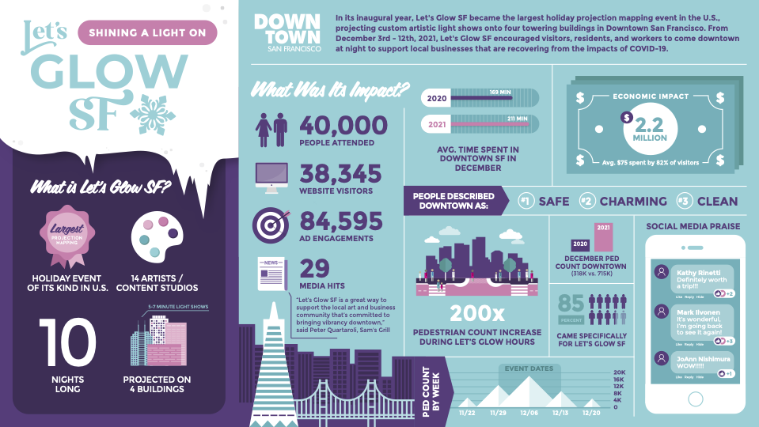

Slide 11
2022 Projections
80,000 - 100,000 in attendance over the 10-night event
$4M economic impact to support Downtown SF businesses
100,000 advertising engagements

Slide 12
BY THE NUMBERS
ADVERTISING & PROMOTION

Slide 13
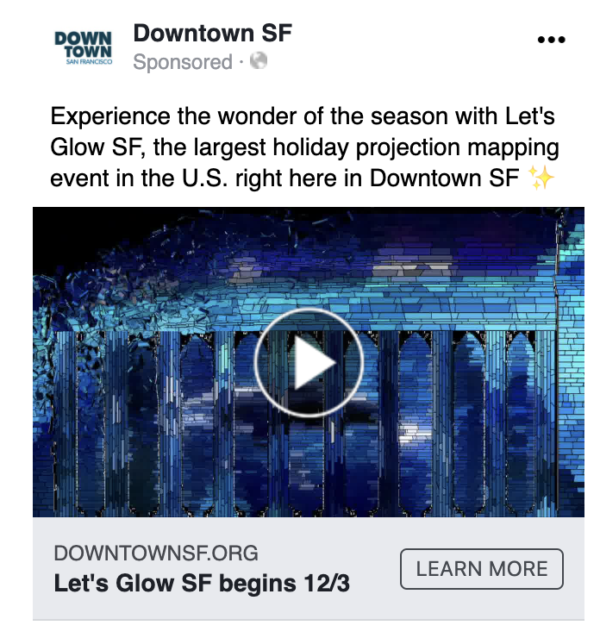
EYES ON LET’S GLOW SF
ADVERTISING & PROMOTION
Being an extremely visual event, Let’s Glow SF lends itself well to the digital media space.
In 2021, social advertising on Facebook and Instagram drove region-wide awareness and encouraged attendees to share their experience with their own followers.
97,854 people saw Let’s Glow SF on Facebook and Instagram ads
The ads were extremely effective: People engaged with them 84,595 times
Over 9,000 people visited the site directly from an advertisement on social
In 2021, Let’s Glow SF was promoted through both outdoor and digital advertising. Outdoor promotions included billboards throughout the Bay Area, bus stops throughout San Francisco, and advertising at BART stations.
Digital promotions included social media advertisements, local event calendar listings, email features targeting Bay Area families, residents, workers, and social media partnerships with local influencers.

Slide 14
BY THE NUMBERS
PUBLIC RELATIONS

Slide 15
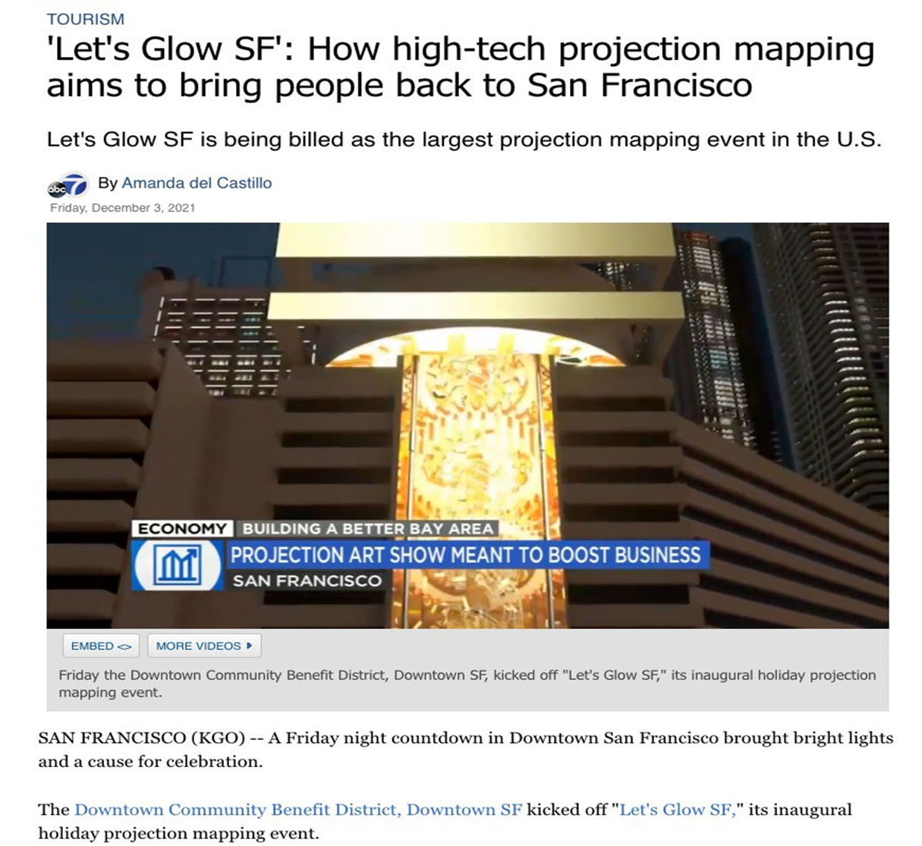
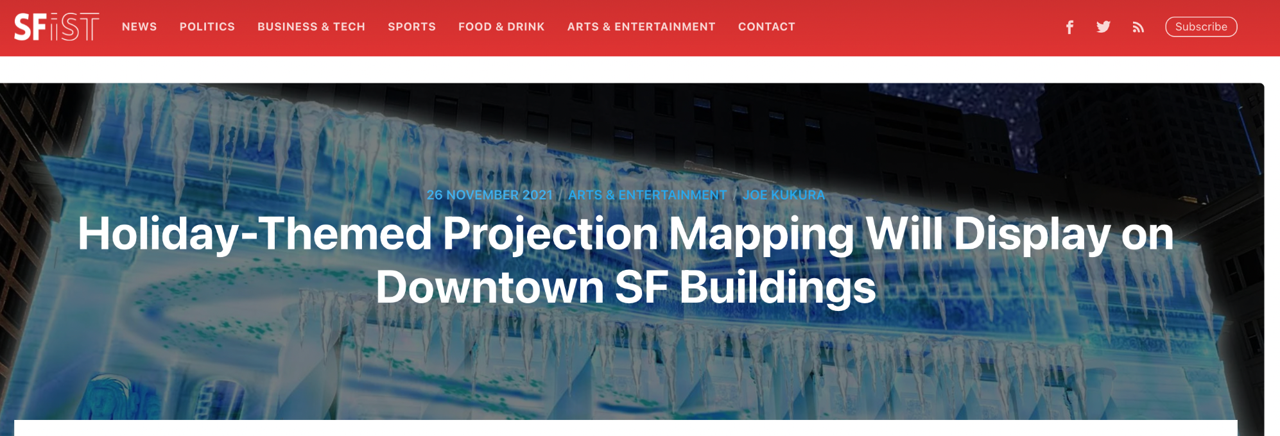
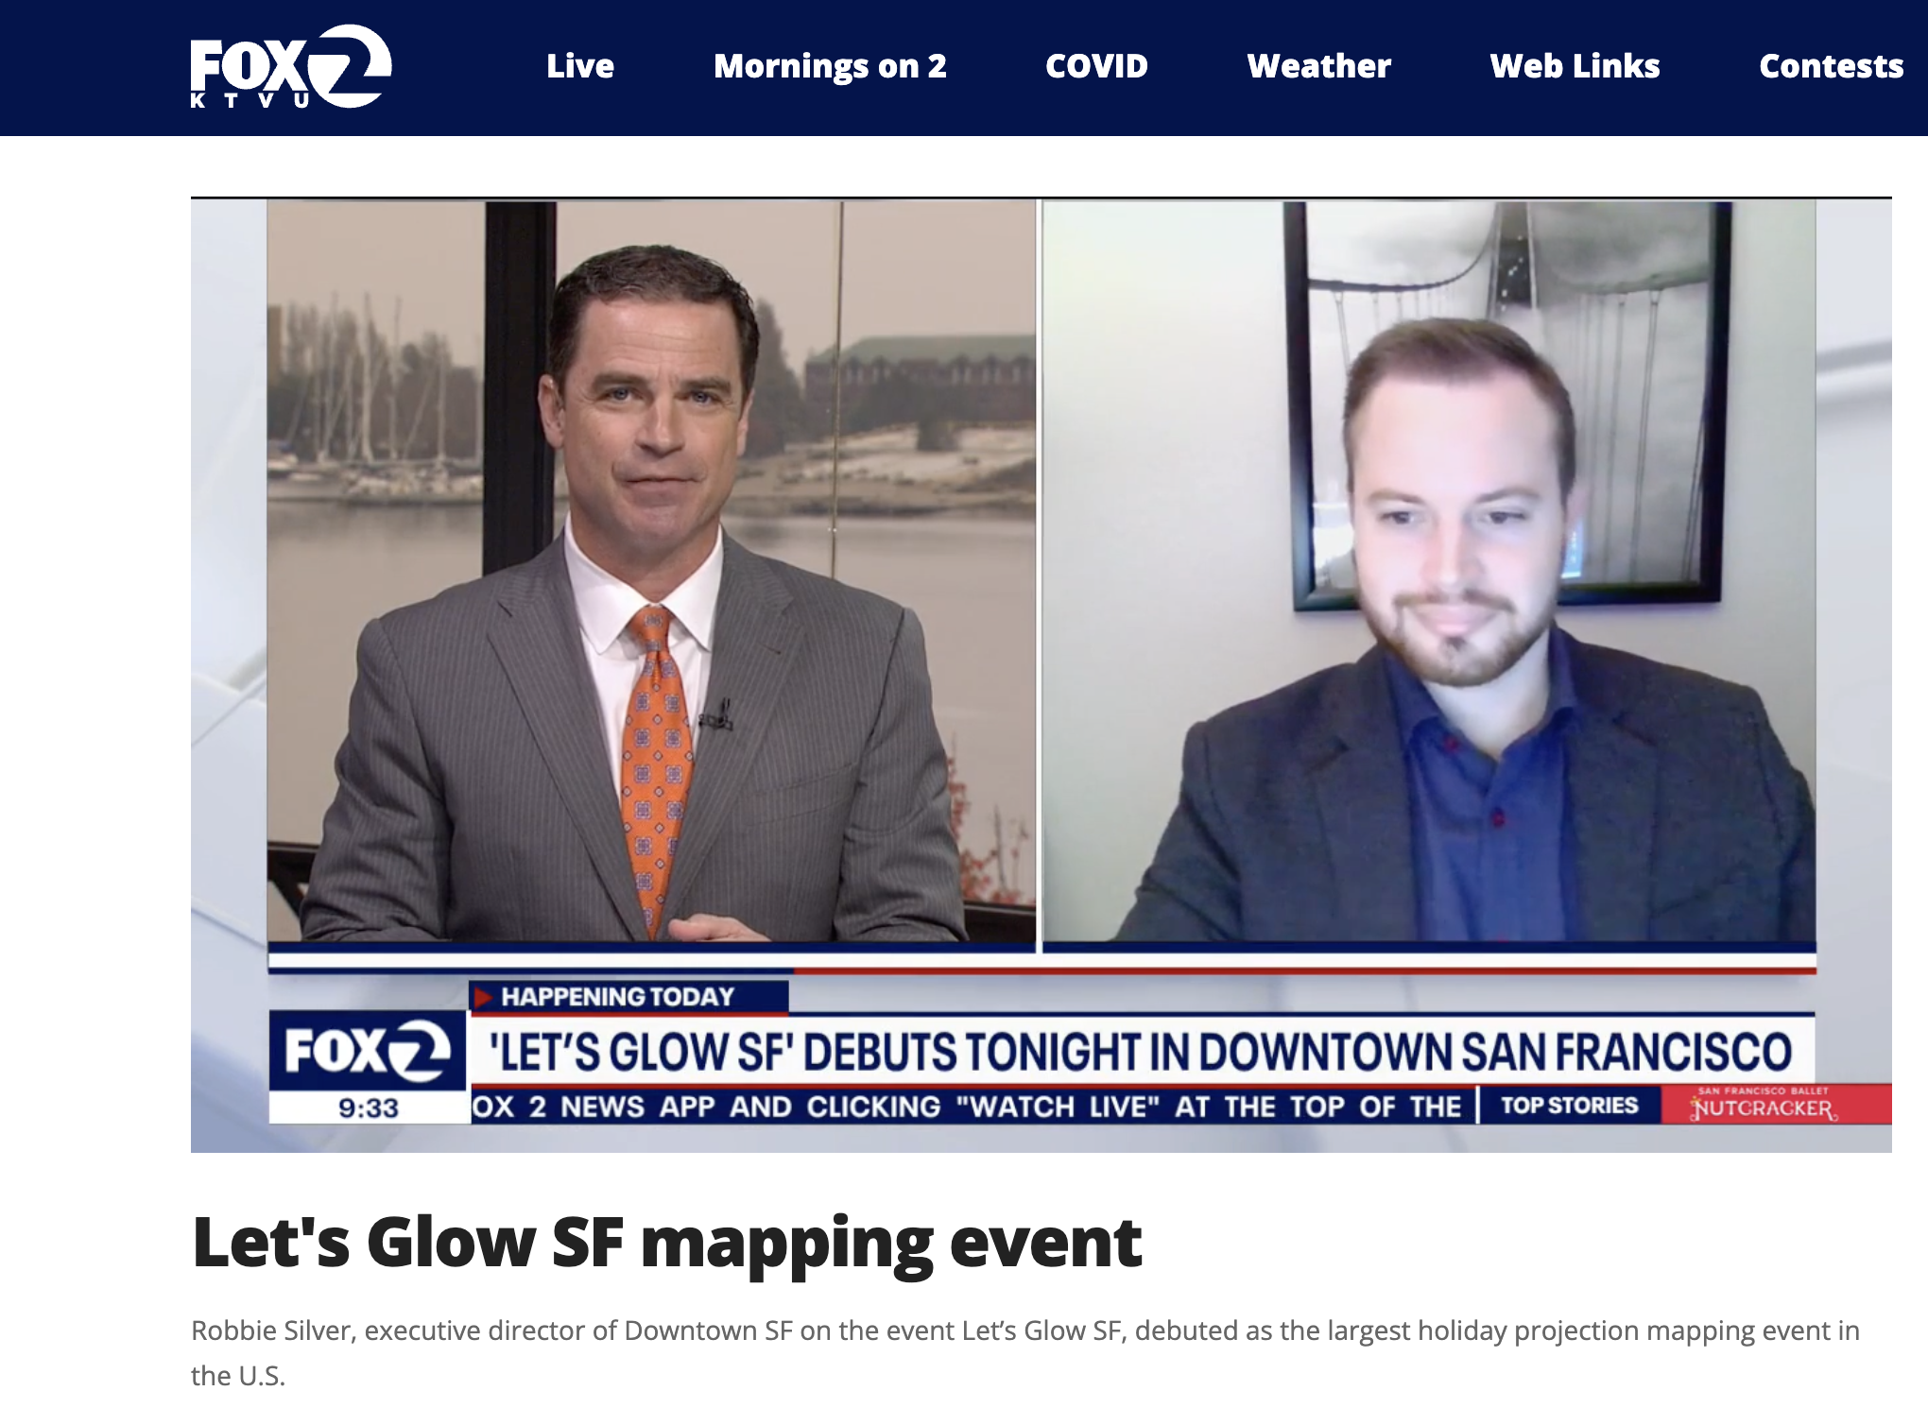
EYES ON LET’S GLOW SF
PUBLIC RELATIONS
Let’s Glow SF’s media kit was distributed to approximately 3,000 media outlets on November 23 through a purchased package through News Wire and sending to local, state, regional and national media including the Wall Street Journal, The Washington Post, New York Times, Yahoo Finance, Google and more.
Coverage totaled 29 media placements, including:​
Features on 4 major local TV stations (ABC7, NBC11, CBS5 and FOX2) - 21 online hits including 11 calendar listing mentions​
6 in depth stories/mentions featuring Let’s Glow SF (SFist, World Journal, SFGate, Thrillist, Do the Bay, San Francisco Examiner)

Slide 16
LET’S GLOW 2022
GETTING INVOLVED - SPONSORSHIPS

Slide 17
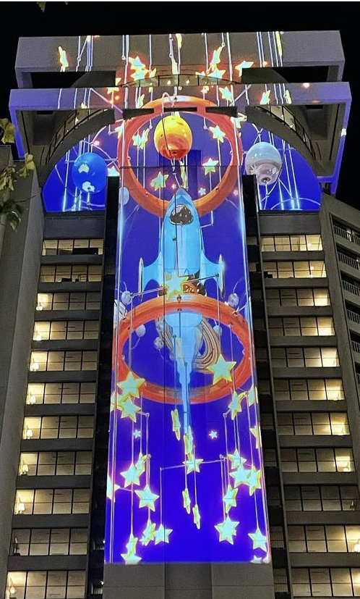
PRESENTING SPONSOR
$100,000
Contribute in making a significant investment in the economic recovery of downtown San Francisco.
Limited to one sponsor
Logo displayed during the countdown timer before each show
Logo displayed after each light show during the end credits
Speaking opportunity during the Switch-On Ceremony & Press Conference on Friday, December 2nd, 2022 with the Mayor
Quote in all press release distributions
Interview in 2022 and 2023 promotional videos
Dedicated blog and social media post
“Presenting Sponsor” and logo on all applicable onsite signage
(10) Tickets to VIP Event after the Switch-On Ceremony
“Presenting Sponsor” and logo on the DowntownSF.org website - all year
“Presenting Sponsor” and logo on all applicable marketing materials

Slide 18
PLATINUM SPONSOR
$75,000
Platinum sponsorships are ideal for those seeking to be featured on all
Let’s Glow SF building locations.
Limited to 6 sponsors
Logo displayed after each light show during the end credits - each location
Verbal recognition during Switch-On Ceremony & Press Conference
Mention in all press release distributions as a “Platinum Sponsor”
“Platinum Sponsor” and logo on all applicable onsite signage
(6) Tickets to VIP Event after the Switch-On Ceremony
Sponsor a blog post on the DowntownSF.com website - 250 words
“Platinum Sponsor” and logo on the event website - all year
“Platinum Sponsor” and logo on all applicable marketing materials

Slide 19
GOLD SPONSOR
$50,000
Gold sponsorships are ideal for those seeking to be featured at one specific
Let’s Glow SF building location.
Limited to 6 sponsors
Logo displayed after each light show during the end credits - one location
Verbal recognition during Switch-On Ceremony & Press Conference
“Gold Sponsor” and logo on applicable onsite signage - one location
(4) Tickets to VIP Event after the Switch-On Ceremony
“Gold Sponsor” and logo on the event website - all year
“Gold Sponsor” and logo on all applicable marketing materials

Slide 20
BUILDING LOCATION SPONSOR
$30,000 - $45,000
This sponsorship option is ideal for property owners and managers that are looking to play an active role in the revitalization of Downtown San Francisco in a post-COVID world by hosting a Let’s Glow SF digital light show on their building.
Downtown SF fiscally sponsored 100% of event costs in Year 1, 2021. To participate as a Year 2 location in December 2022, host locations will be responsible for 20% of their respective building’s costs. This includes equipment and labor, digital content, and security. Downtown SF is committed to funding the remaining 80%.
2021 Locations: One Bush, Hyatt Regency, 345 California, Stock Exchange

Slide 21
SHOW SPONSOR
$25,000
Support the work of local artists by sponsoring a show!
Limited to 6 sponsors
Name prominently displayed after each show during the end credits, supporting the contributing artist’s work
(2) Tickets to VIP Event after the Switch-On Ceremony & Press Conference
“Show Sponsor” and logo on the event website - all year
“Show Sponsor” and logo on all applicable marketing materials

Slide 22
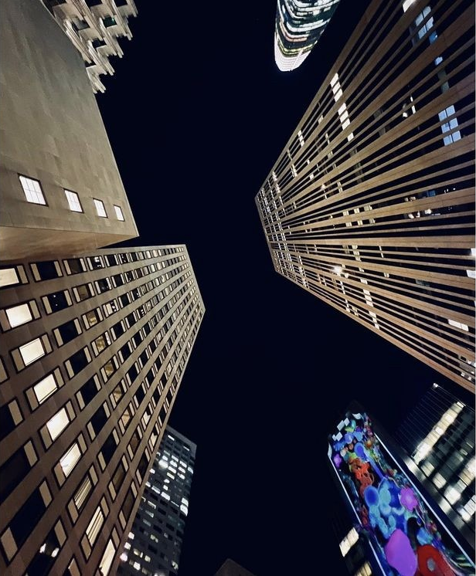
FRIENDS OF DOWNTOWN SPONSOR
$15,000
Making the arts accessible to all is a crucial part of reigniting the wonder of this resilient city in a post-lockdown world. By becoming a Friends of Downtown Sponsor, you’re ensuring that we can continue to provide opportunities for local artists to display their work on a massive scale.
(2) Tickets to VIP Event after the Switch-On Ceremony & Press Conference
Name recognition on VIP event signage
“Friends of Downtown SF” name on the DowntownSF.org website - all year
“Friends of Downtown SF” name on all applicable marketing materials and digital promotions

Slide 23
How Does Logo Placement Work?
Let’s Glow SF runs for 10 nights and 4.5 hours each night.
Depending on programming and timing, building locations could have 1-3 light shows that are 3 min, 5 min or 7 min long respectfully. Light shows play every 15 min on the 15 mark followed by a 1 min countdown timer. Timing gaps will feature unique still works from local artists.
Presenting - Logo on 3-5 min countdown timer (4x per hour) & (18x per night) & (180x total)
Logo after each show during end credits (4x-12x per hour) (x6 locations)
Platinum - Logo after each show during the end credits (4x-12x per hour) (x6 locations)
Gold - Logo after each show, one location (4x-12 per hour)

Slide 24
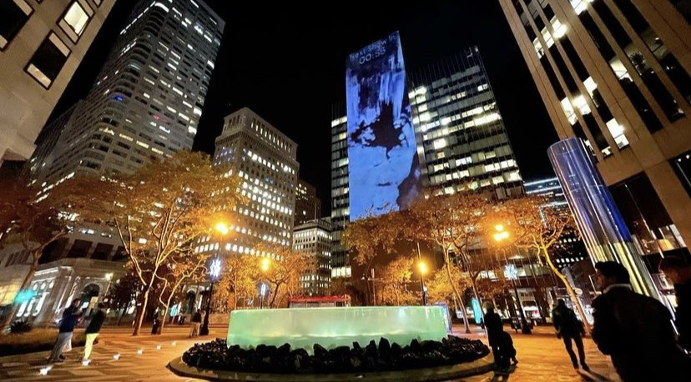
MEDIA SPONSOR
$15,000
Contribute by providing at least $15,000 in as in-kind advertising buys to promote Let’s Glow SF 2022
(2) Tickets to VIP Event after the Switch-On Ceremony & Press Conference
Name recognition on VIP event signage
“Media Sponsor” and name on the DowntownSF.org website - all year
“Media Sponsor” and name on all applicable marketing materials and digital promotions

Slide 25
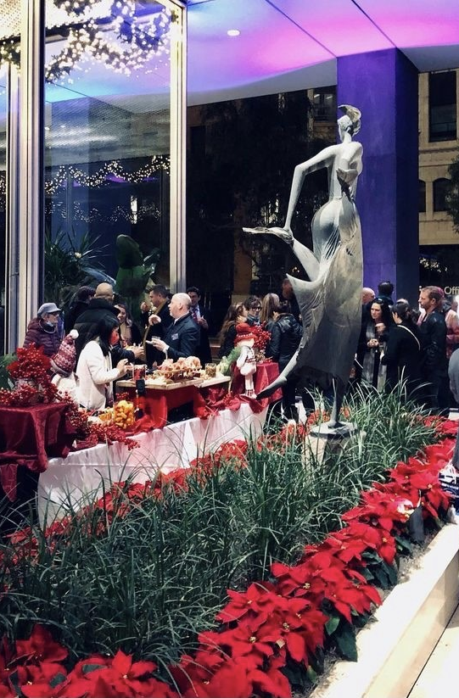
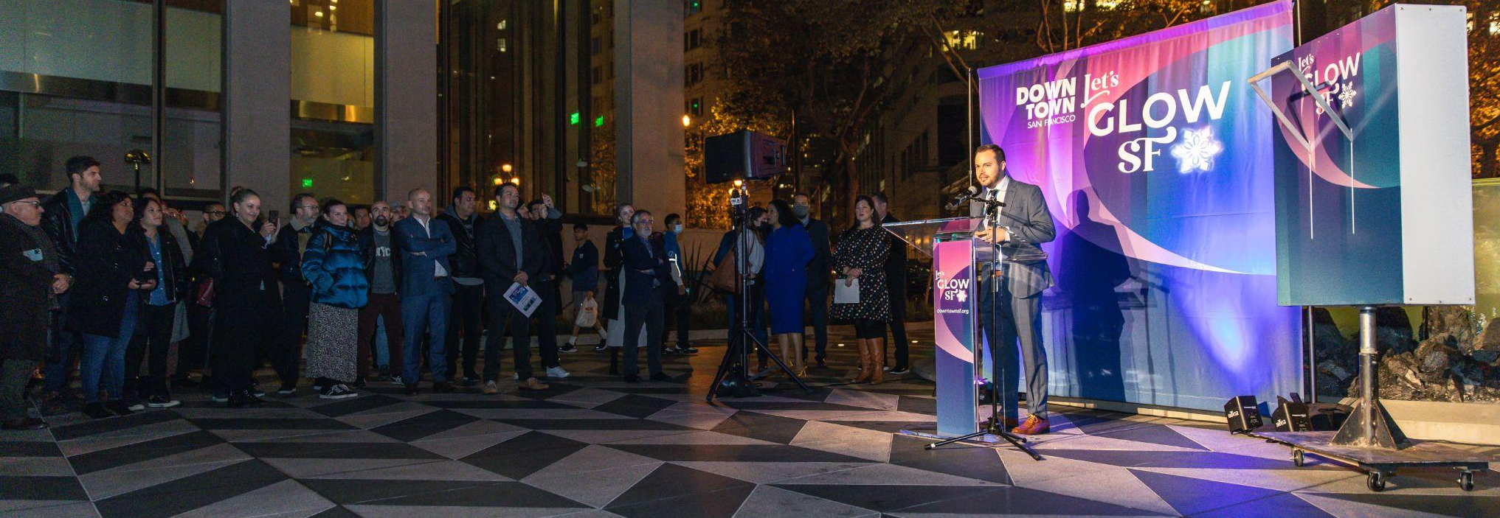
VIP EVENT SPONSOR
Help us kick-off Let’s Glow SF 2022
The VIP Event and Switch-On Press Conference will take place on opening night on Friday, December 2nd, 2022 and will feature community speakers, entertainment, festive beverages, and bites. Be part of this cutting edge celebration of the digital arts while promoting your brand to 150 event attendees.
Band/Entertainment Sponsor : $5,000
Bar Sponsor: $5,000
Appetizer Station Sponsor: $5,000
Cocktail Table Sponsor: $3,000
Sponsors of the VIP event will receive logo recognition on event signage.

Slide 26
LET’S GLOW 2022
GETTING INVOLVED - Brand/Artist Collaborations

Slide 27
Let's Glow Brand/Artist Collaboration Sponsorship Package offers the unique opportunity for brands to collaborate with world-class projection mapping artists on a massive canvas. Working with branding guidelines such as color choices, shapes, and branding elements our artists can create a stunning piece of projection art with the look and feel of your brand incorporated.
By sponsoring a Brand/Artist Collaboration, your brand will not only be supporting a San Francisco community event, but also supporting an artist or team of artists to help create your piece.
With a logo blast at the end and branding homages throughout, this sponsor level offers a wonderful way for your company to commission an artistic piece and see ROI with logo placement and marketing opportunities. Sponsors at this level will be granted the ability to use any footage of the activation in their marketing campaigns as well with reference and credit given to Let's Glow SF.

Slide 28
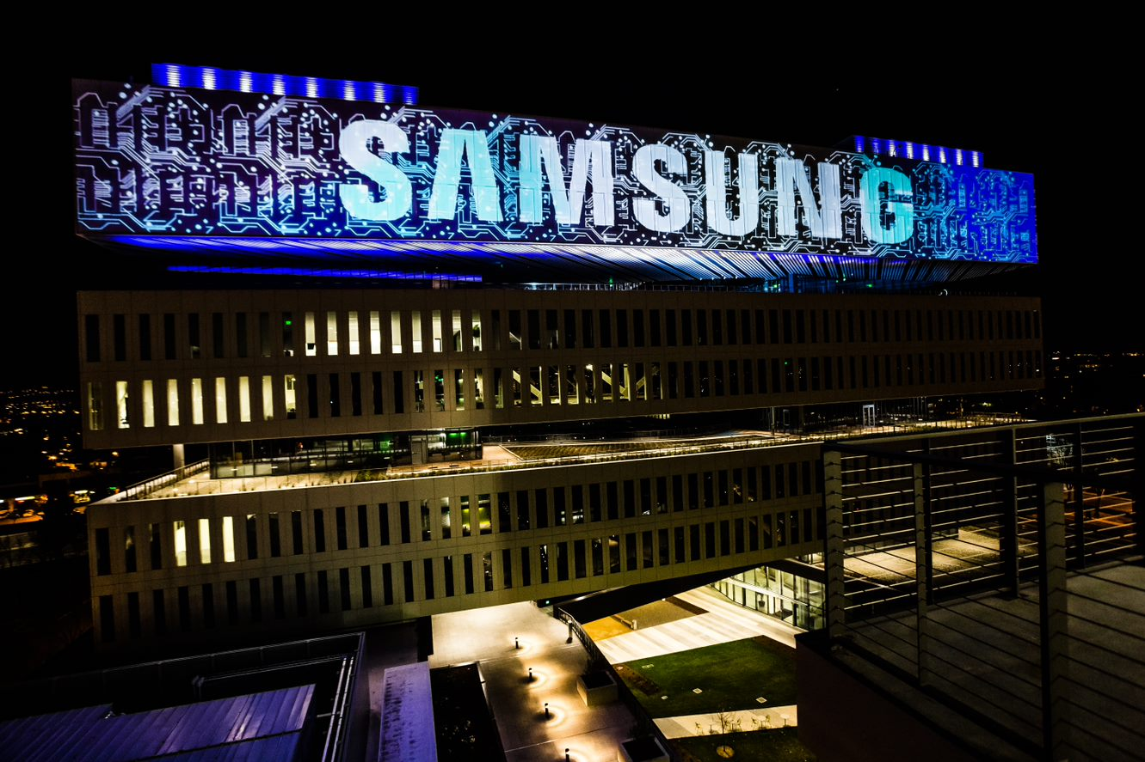
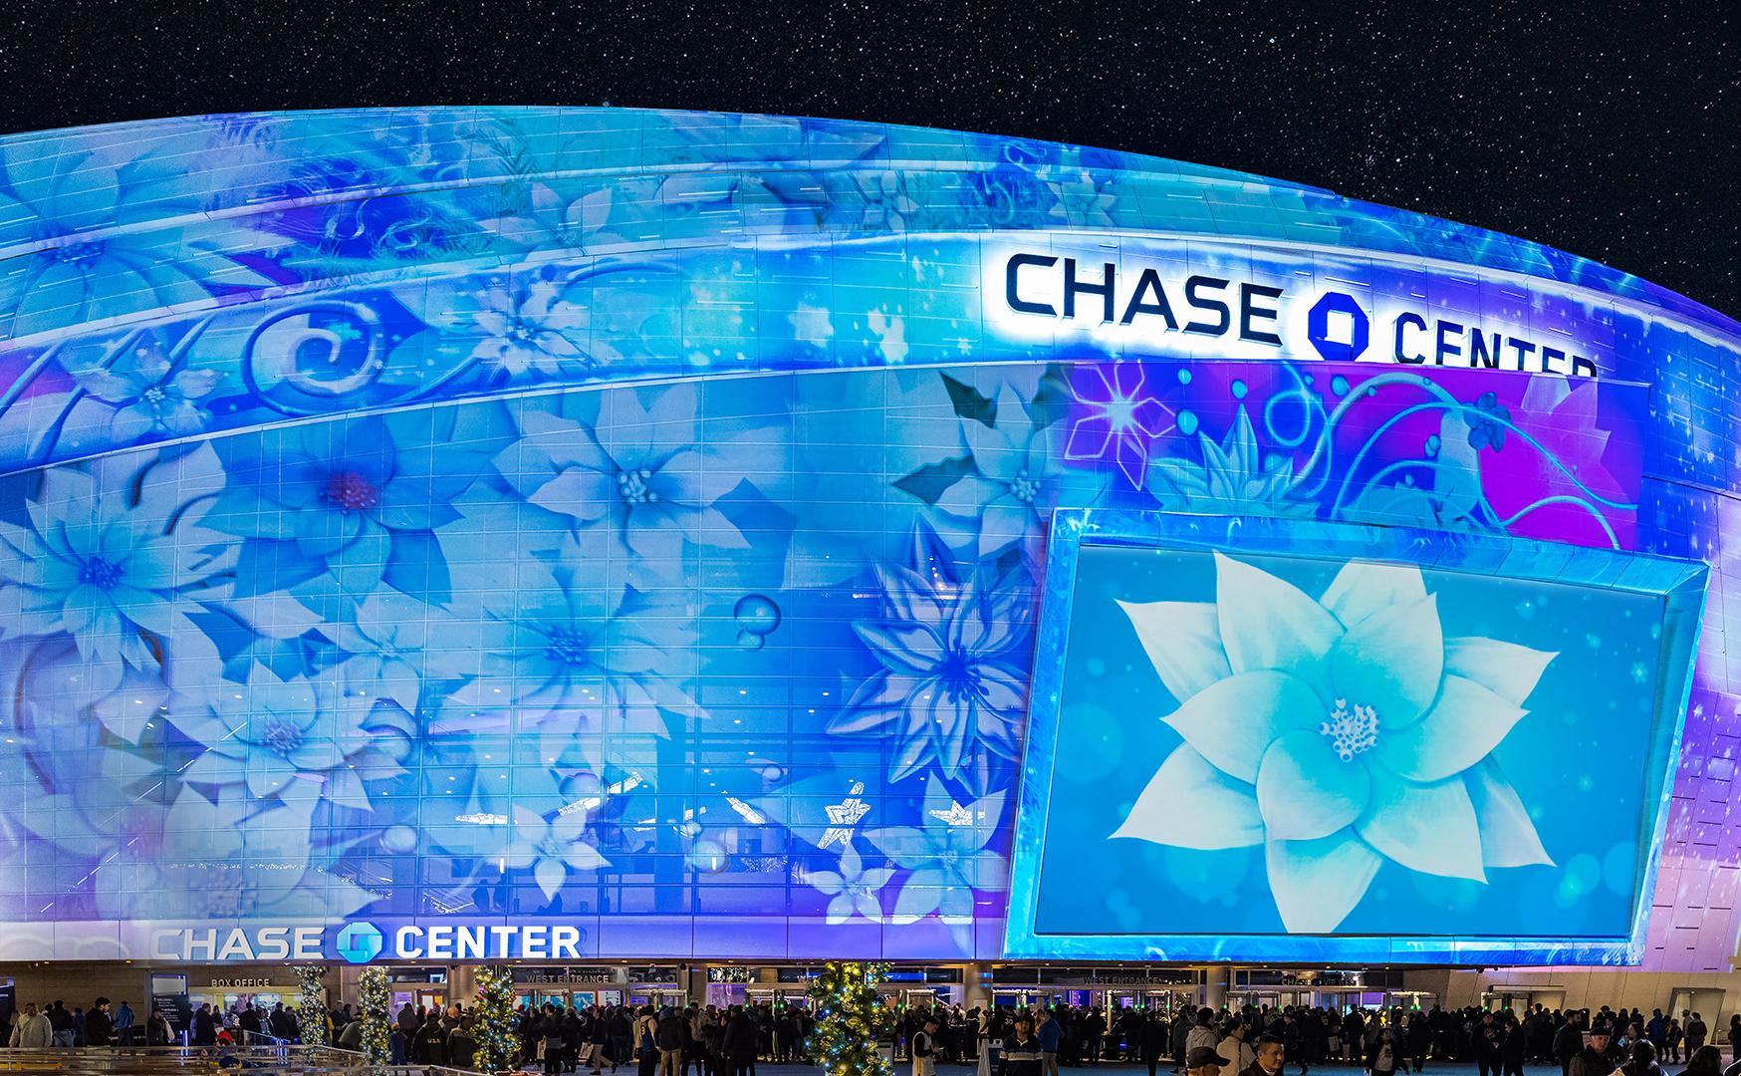
These are strictly examples of a brand/artist collaboration. These do not depict brands that sponsor Let’s Glow SF or participating locations of Let’s Glow SF.

Slide 29
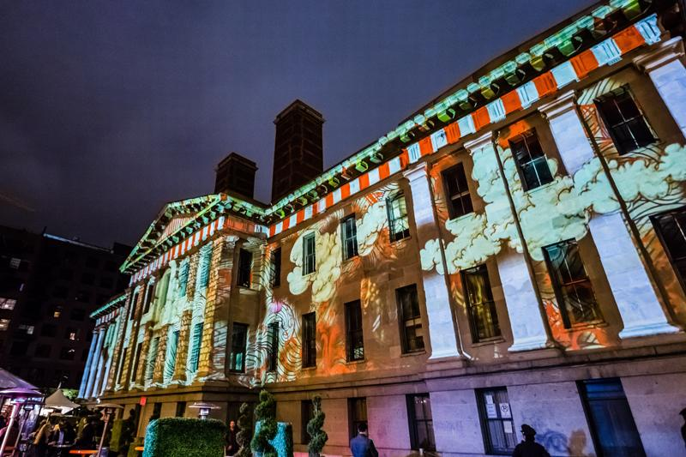
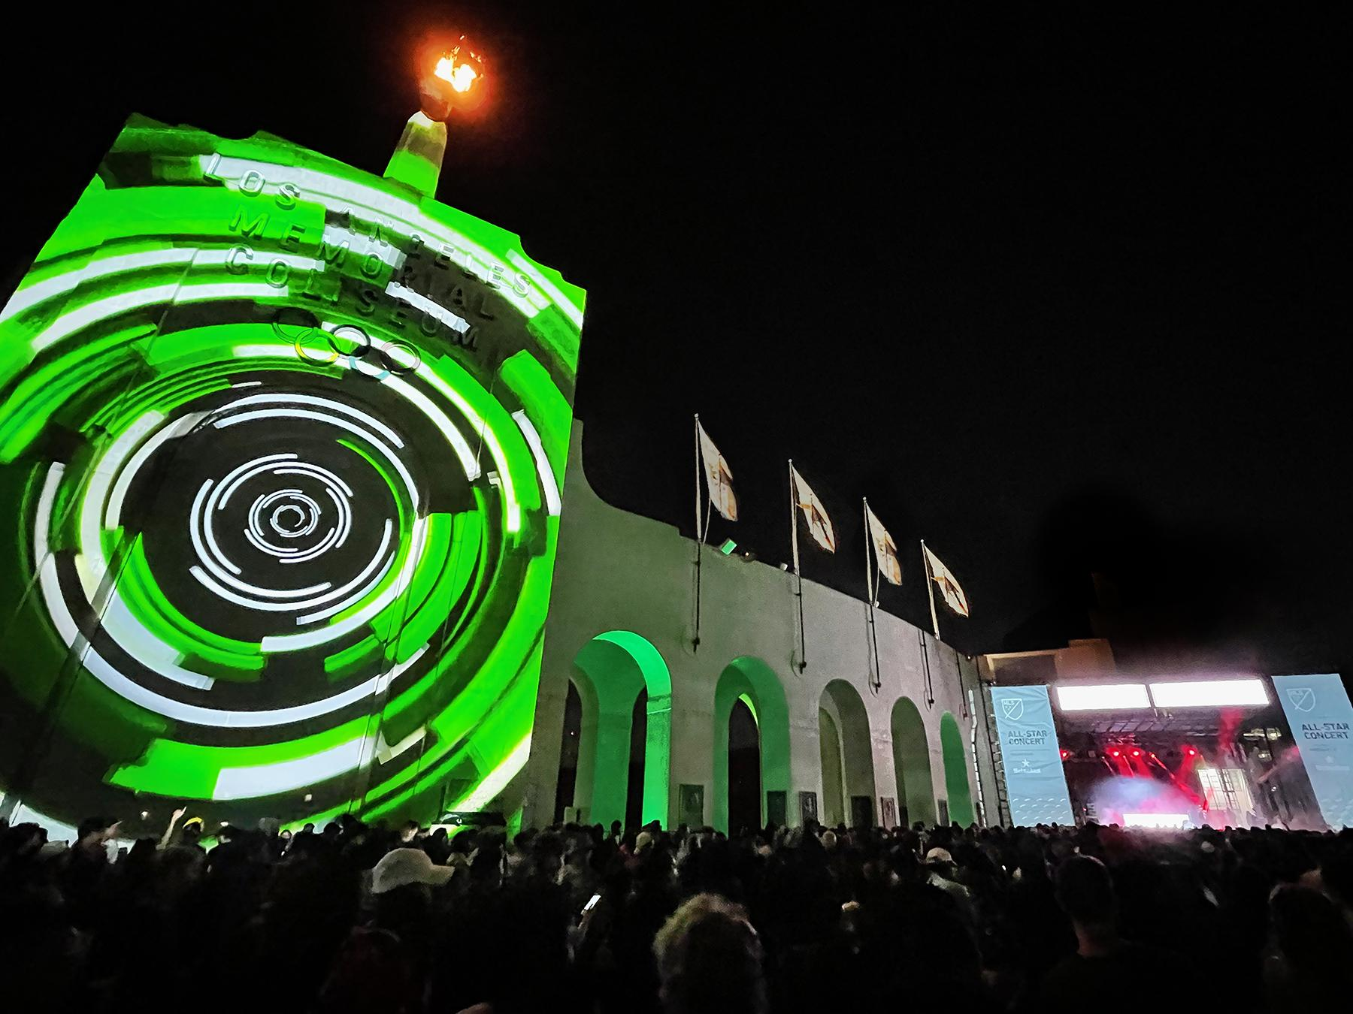
These are strictly examples of a brand/artist collaboration. These do not depict brands that sponsor Let’s Glow SF or participating locations of Let’s Glow SF.

Slide 30
Brand/Artist Collaboration Sponsorship Package
1 minute of Digital Content: $15,000
2 minutes of Digital Content: $25,000
3 minutes of Digital Content: $35,000
Collaborate with a digital artist to provide content while showing off your brand to thousands of attendees
Your brand will be showcased on (1) Let’s Glow SF building location.
Content will be shown 4x per hour/18x per night (180x during the full event duration).
(2) Tickets to VIP Event after the Switch-On Ceremony & Press Conference
“Art Sponsor” and name on the DowntownSF.org website - all year

Slide 31
CONTACT US
Custom packages may be available. Reach out to learn more and to secure your spot.
The Downtown SF Partnership is a 501(c)(3) nonprofit organization. Sponsorships and donations are tax deductible.
Robbie Silver | rsilver@downtownsf.org
Executive Director, Downtown SF Partnership

